Slide 1
Netflix Clone Deployment
Project Documentation Overview
Prepared by Rajesh Pattapu

Slide 2
Phase 1: Deploying Netflix Manually
Launch an EC2 instance using Ubuntu (t2.large).
Update system: sudo apt-get update.
Install Git and Docker: sudo apt-get install git -y, docker.io.
Clone Netflix repository from GitHub.
Build and run Docker image: docker build -t netflix, docker run -dt --name Netflix -p 6060:80 netflix:latest.
Generate TMDB API Key for application integration.
Rebuild the Docker image using TMDB API key.

Slide 3
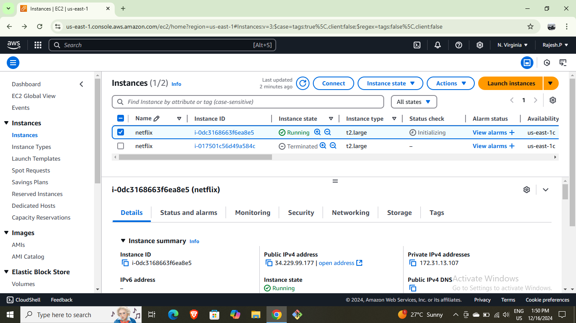
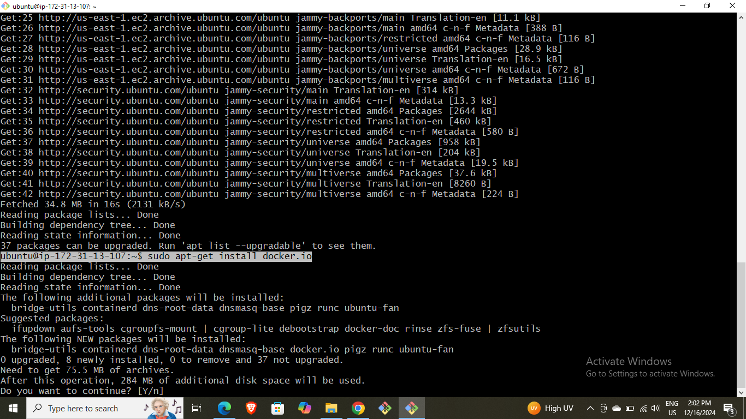
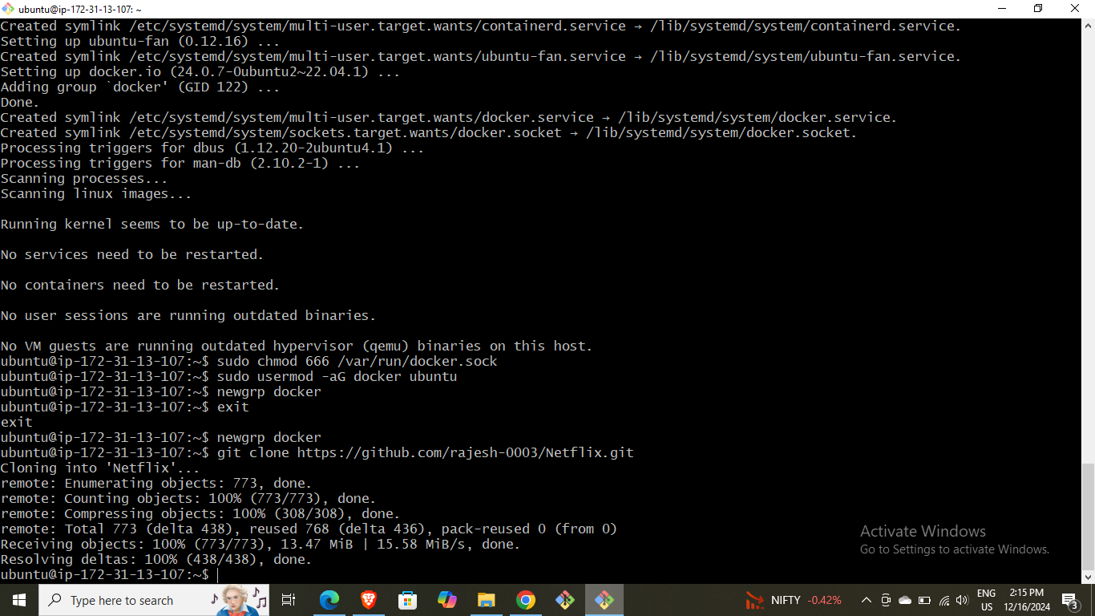
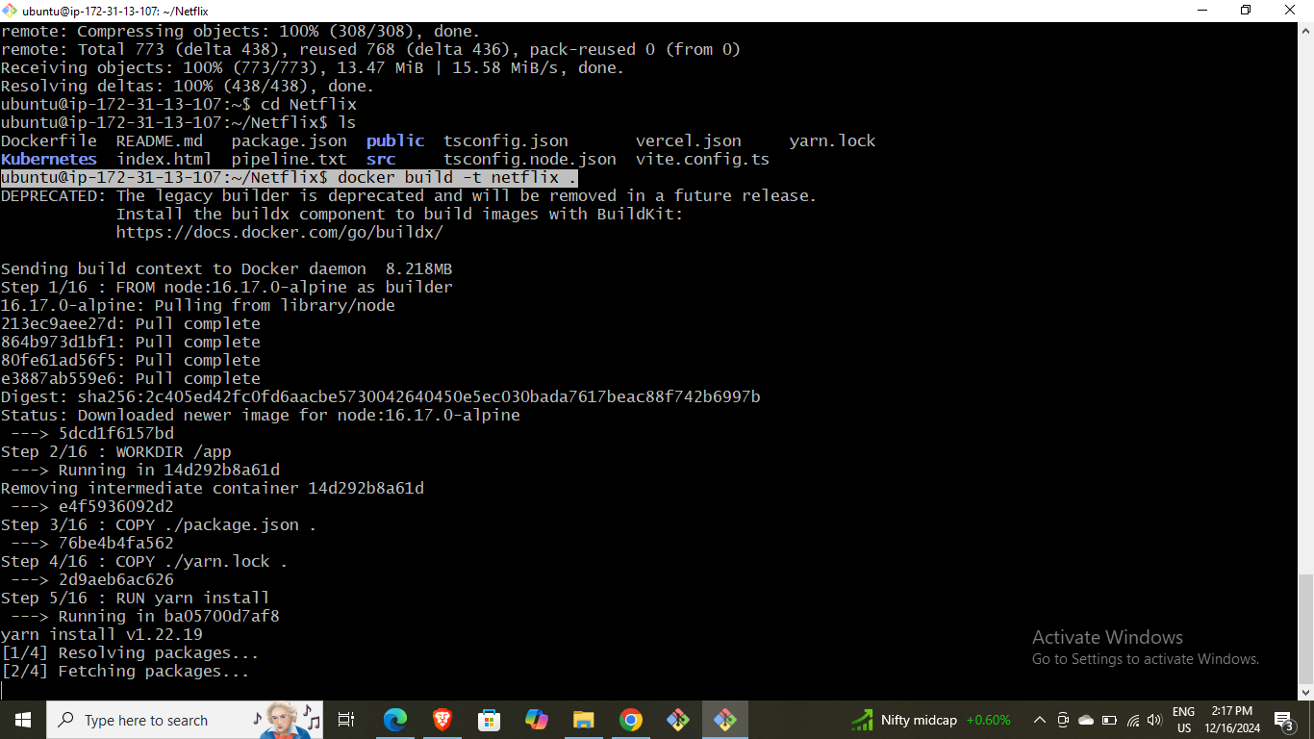
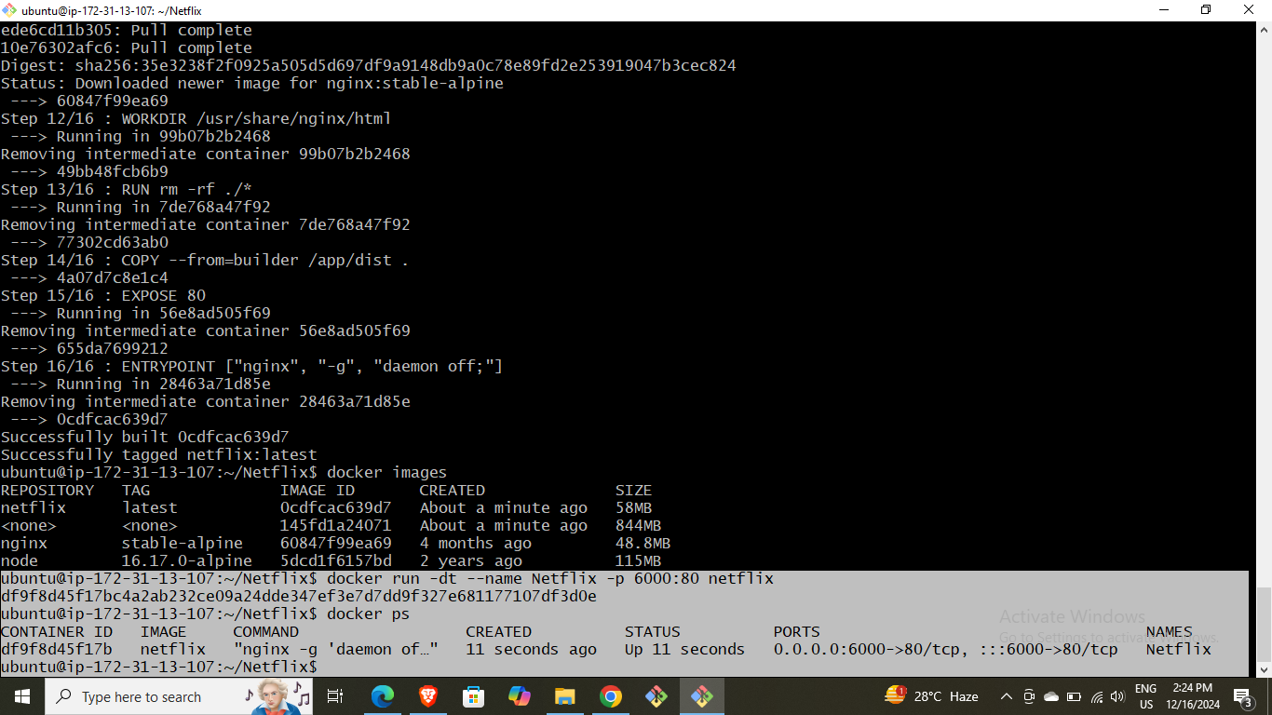
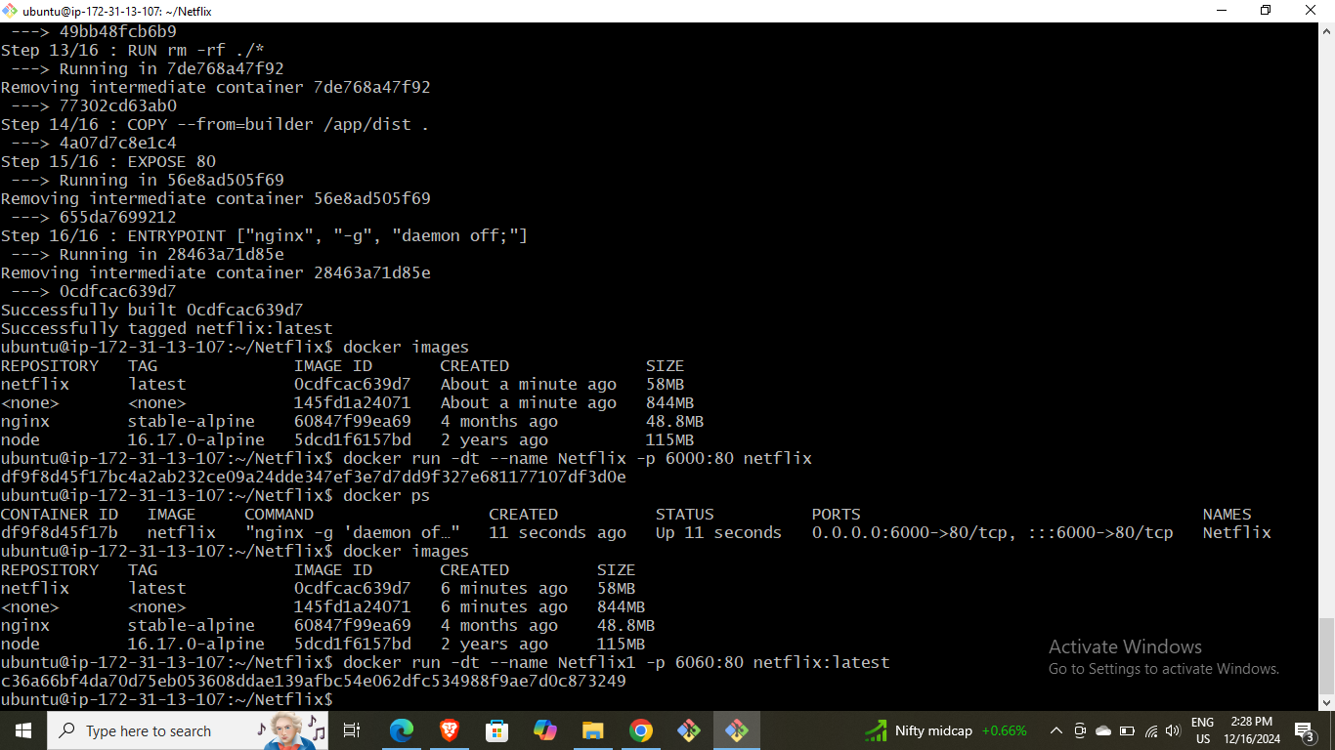
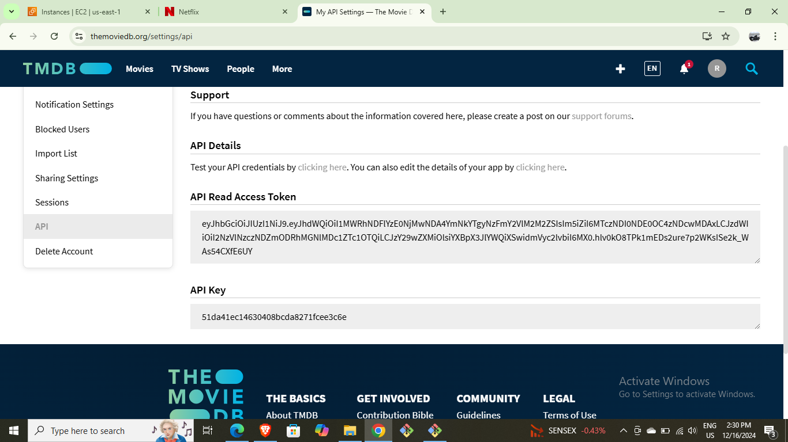
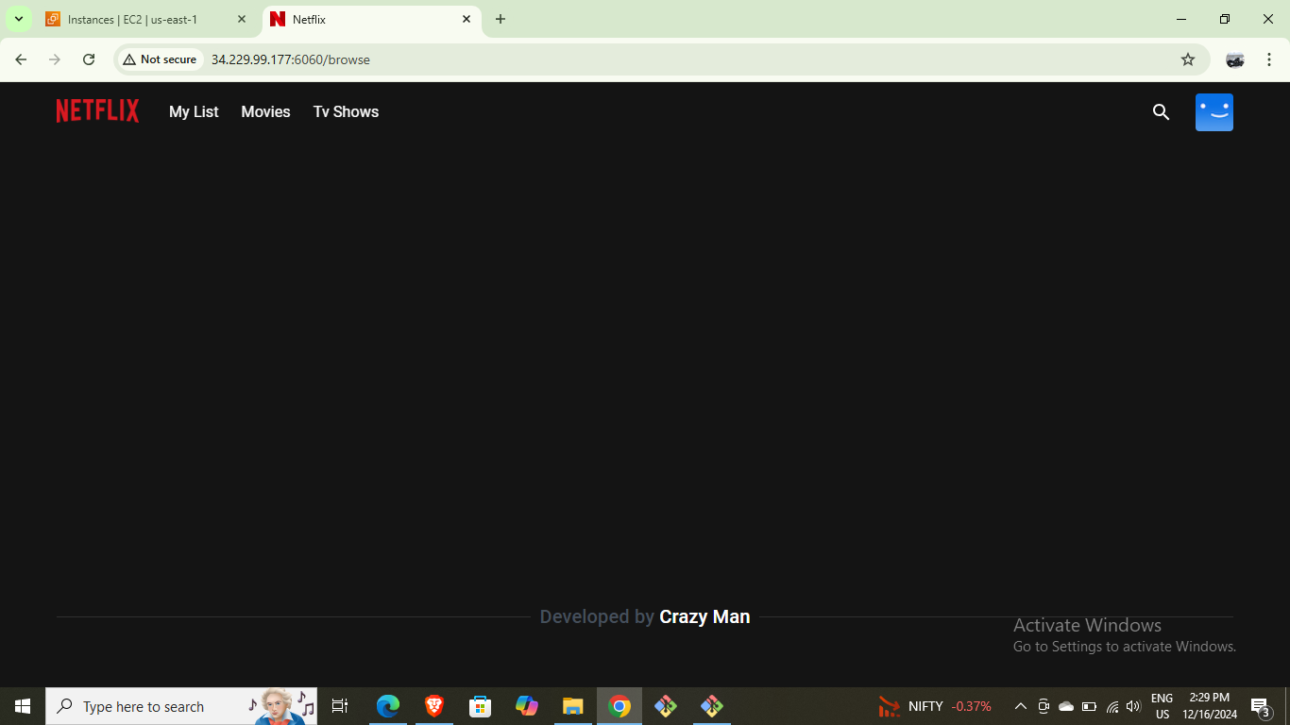
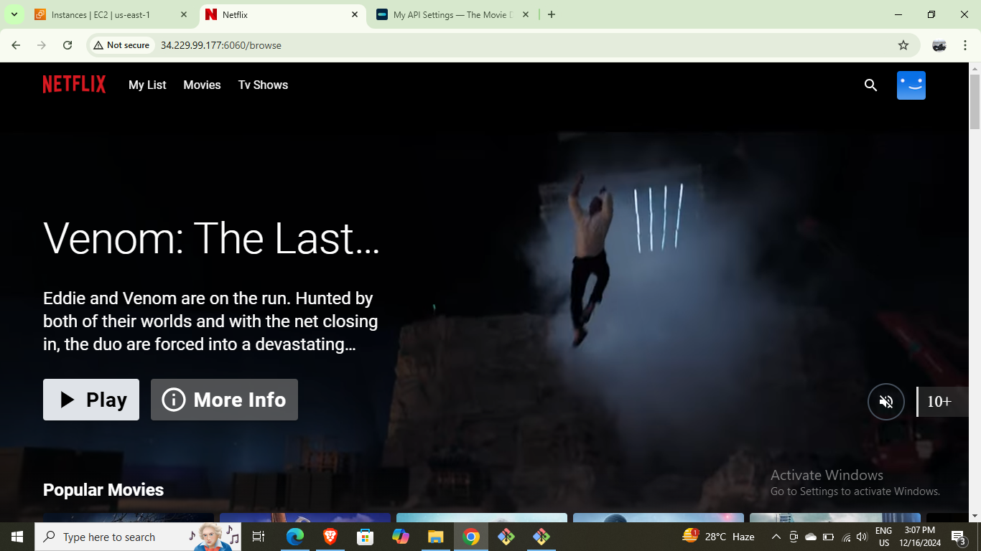

Slide 4
Phase 2: Security with SonarQube & Trivy
Install and run SonarQube for code analysis.
Scan Docker images using Trivy for vulnerabilities.
Command examples: docker run –d –name sonar –p 9000:9000 sonarqube:lts-community, trivy image <image_id>.

Slide 5
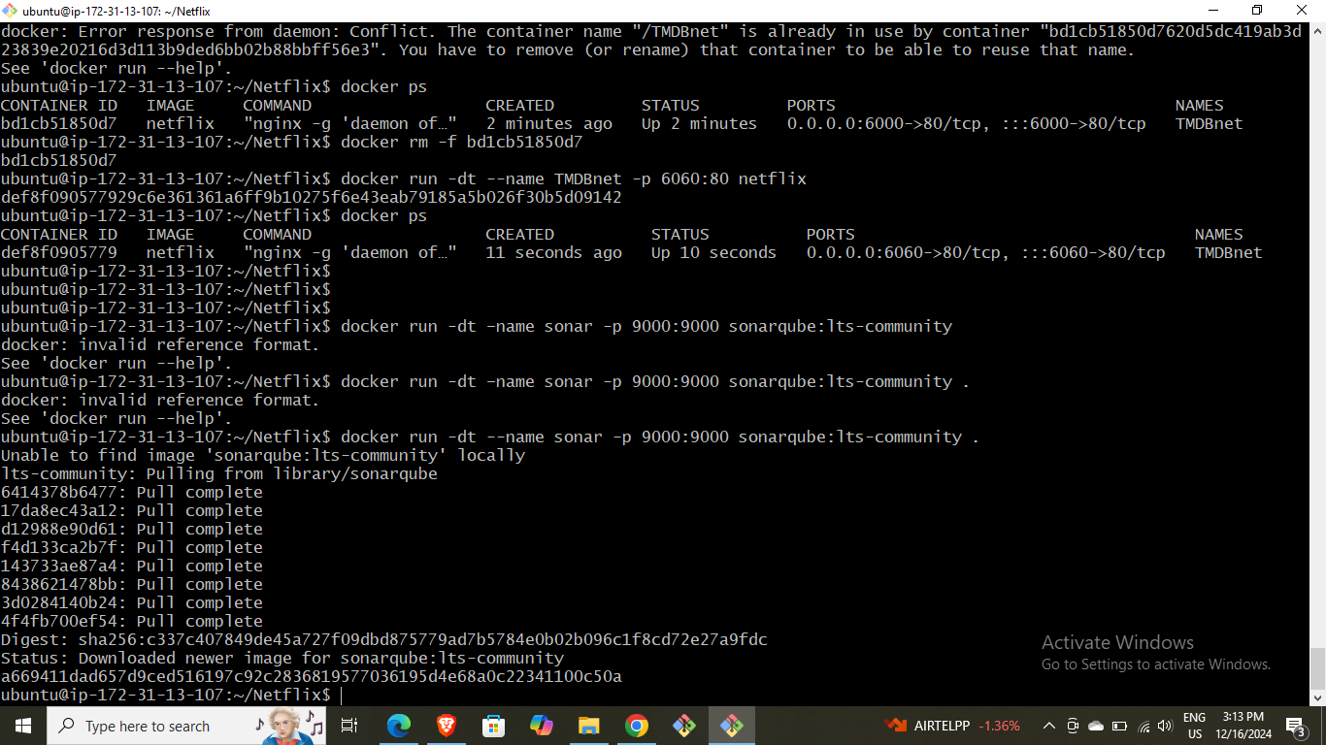
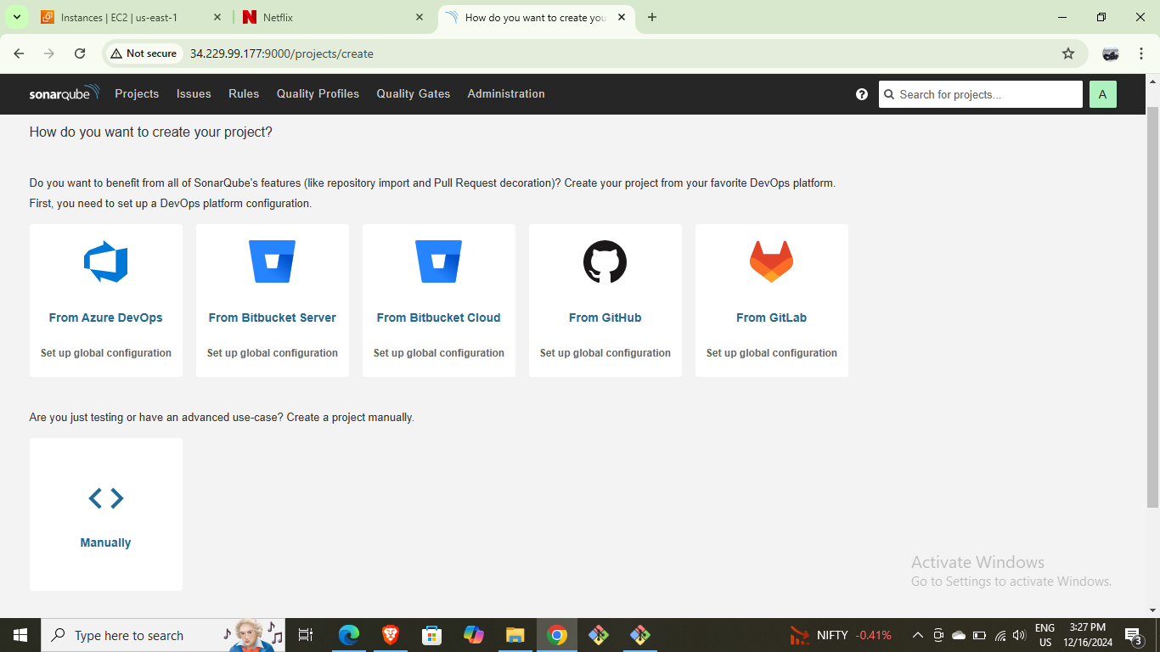
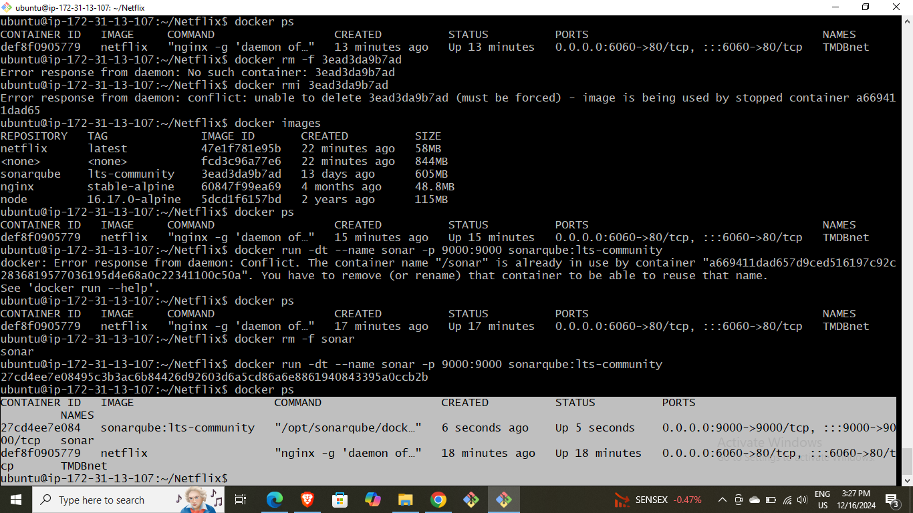
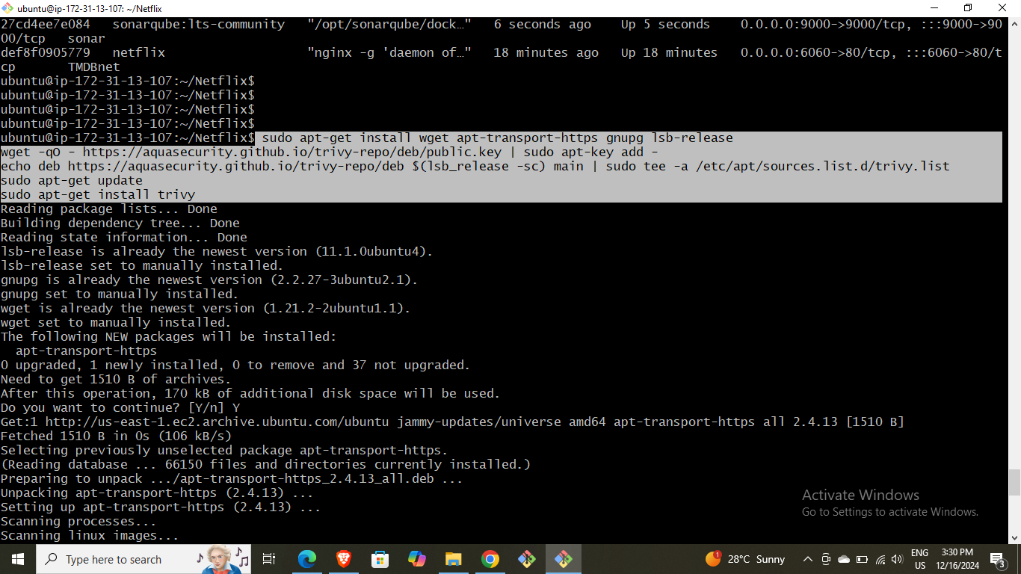
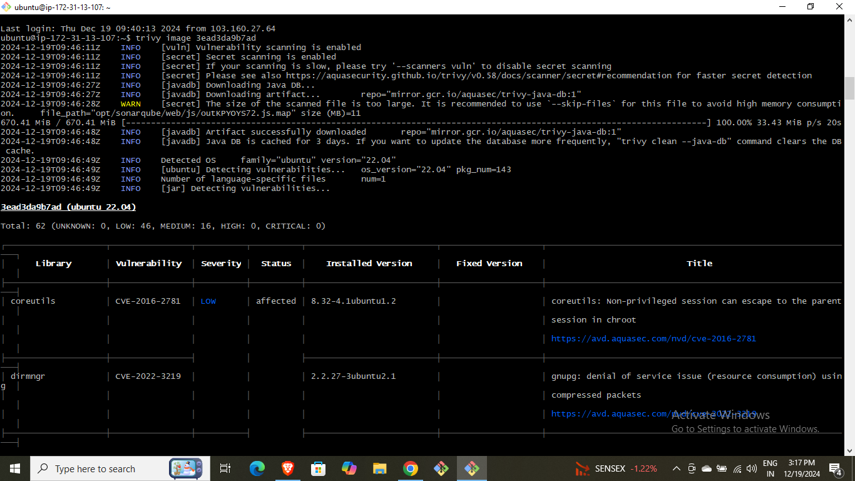
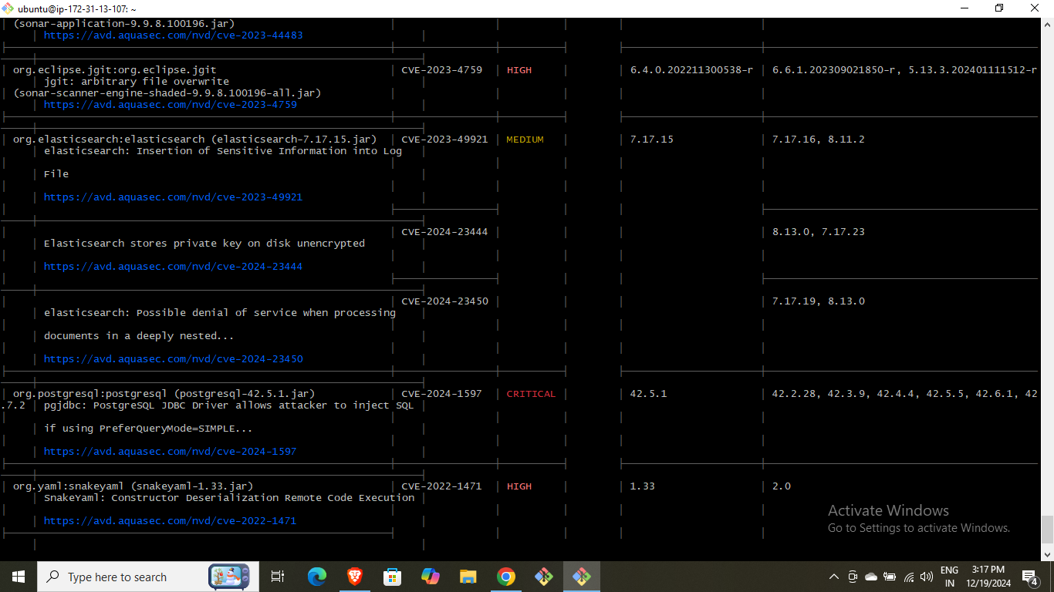

Slide 6
Phase 3: Automating Deployment with Jenkins
Install Jenkins and required plugins.
Configure Jenkins credentials for Docker and SonarQube.
Write and execute Jenkins pipeline script for automated deployment.
Include quality gates, dependency checks, and Docker image scans in the pipeline.

Slide 7
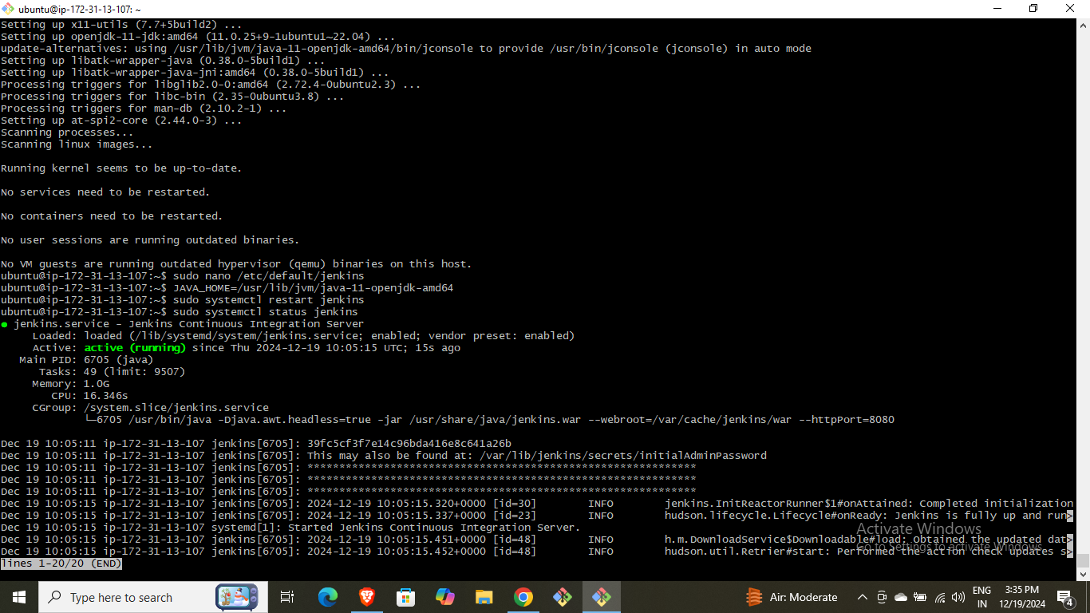
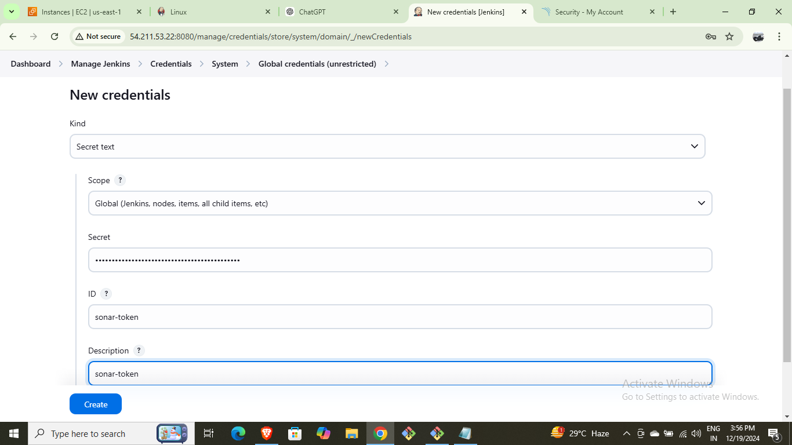
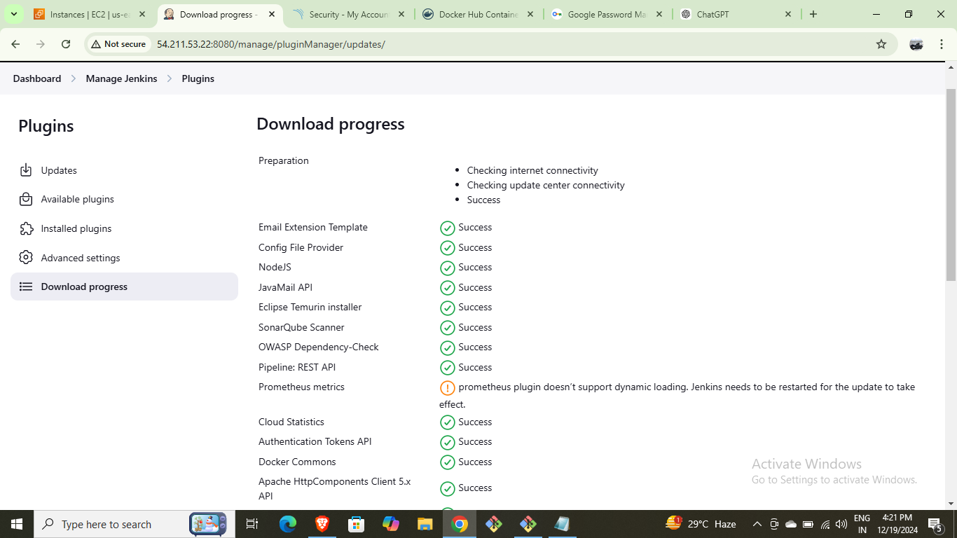
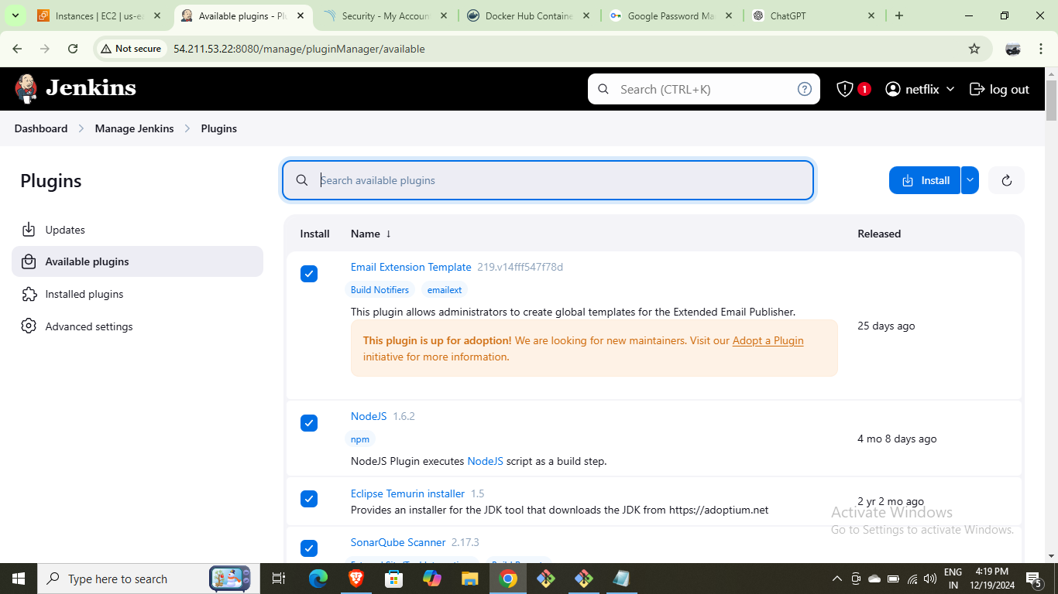
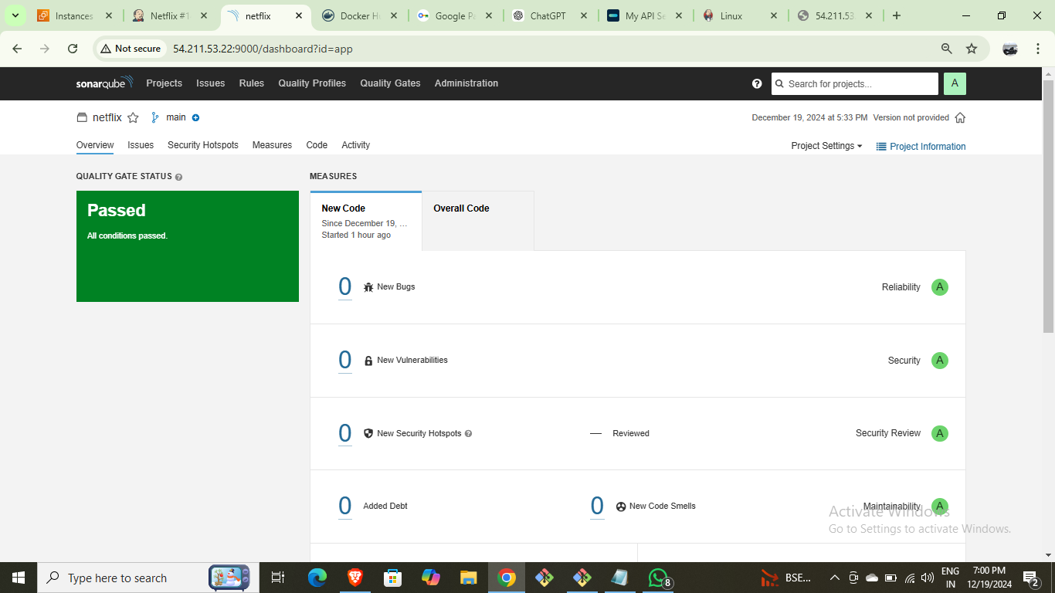
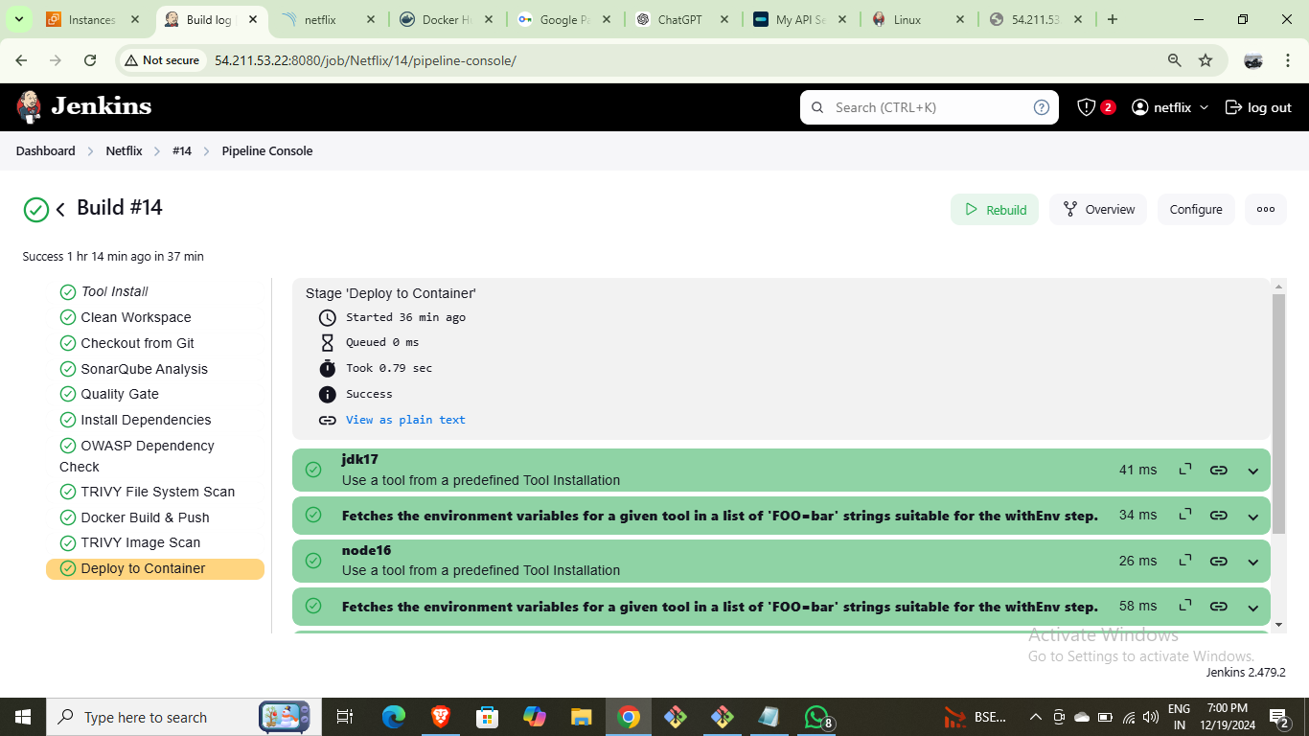
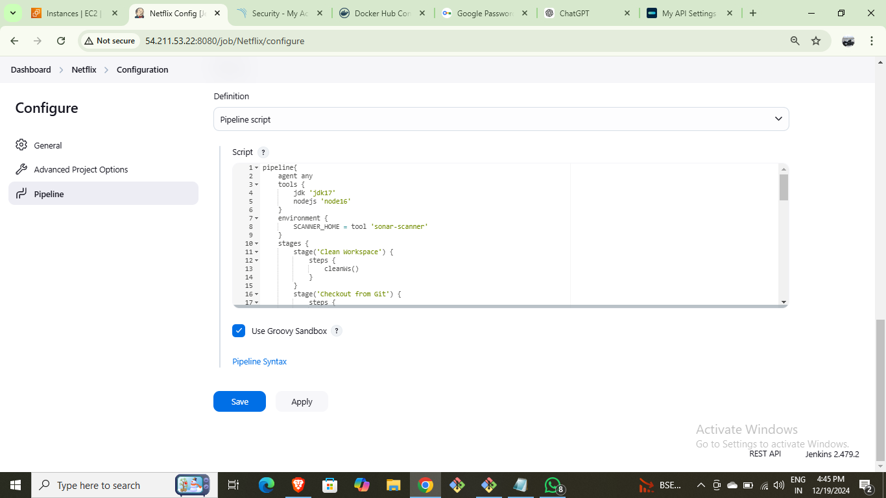
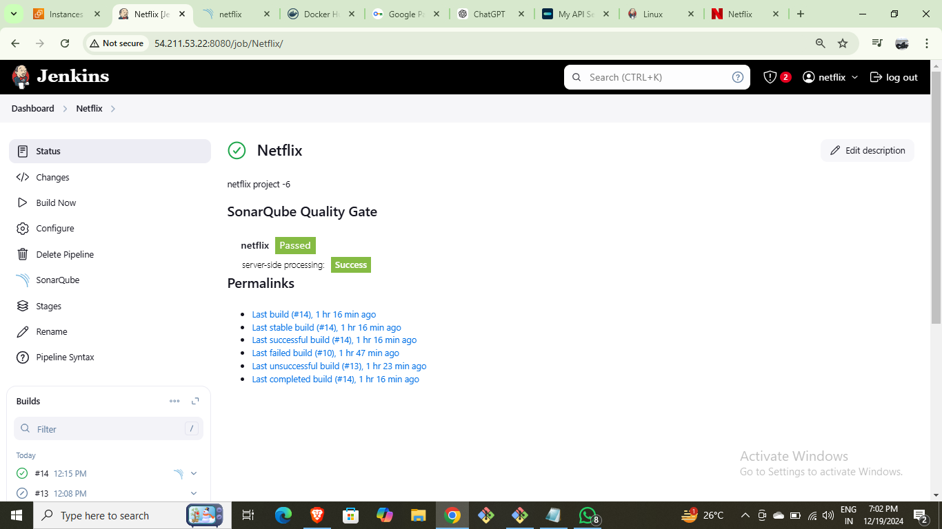
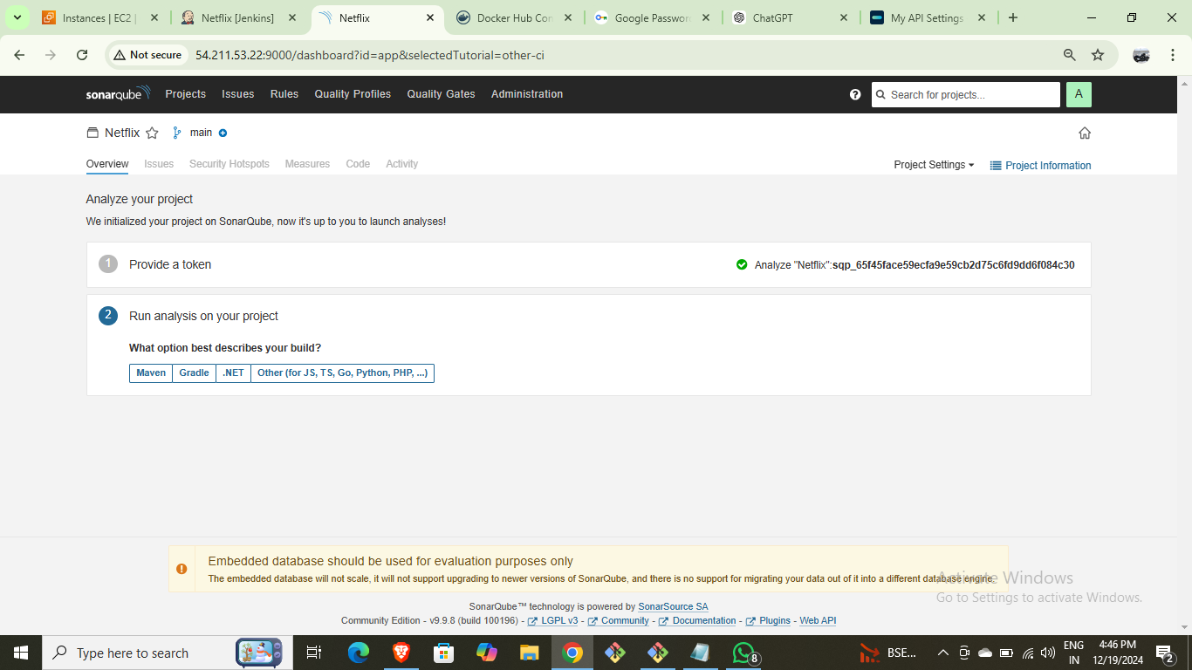

Slide 8
Phase 4: Monitoring via Prometheus & Grafana
Install Prometheus and Node Exporter for system monitoring.
Edit Prometheus.yml to add node exporter configuration.
Install Grafana and integrate Prometheus as a data source.
Create dashboards for Jenkins and system metrics.

Slide 9
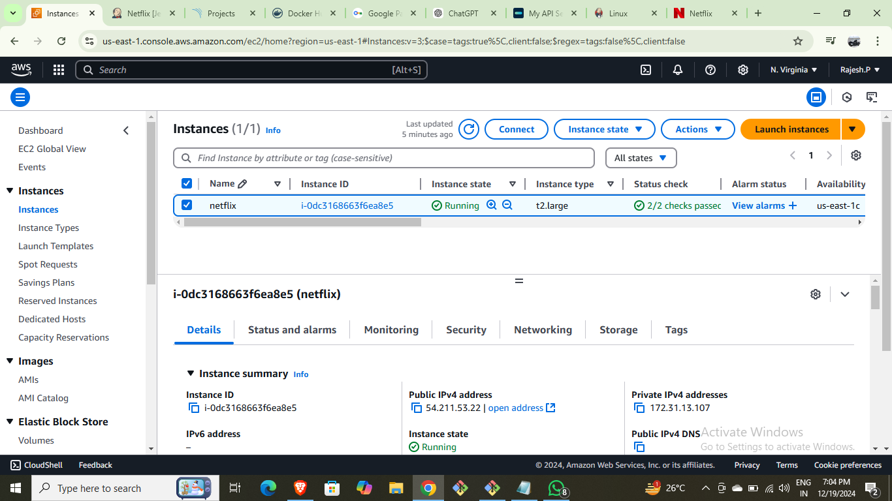
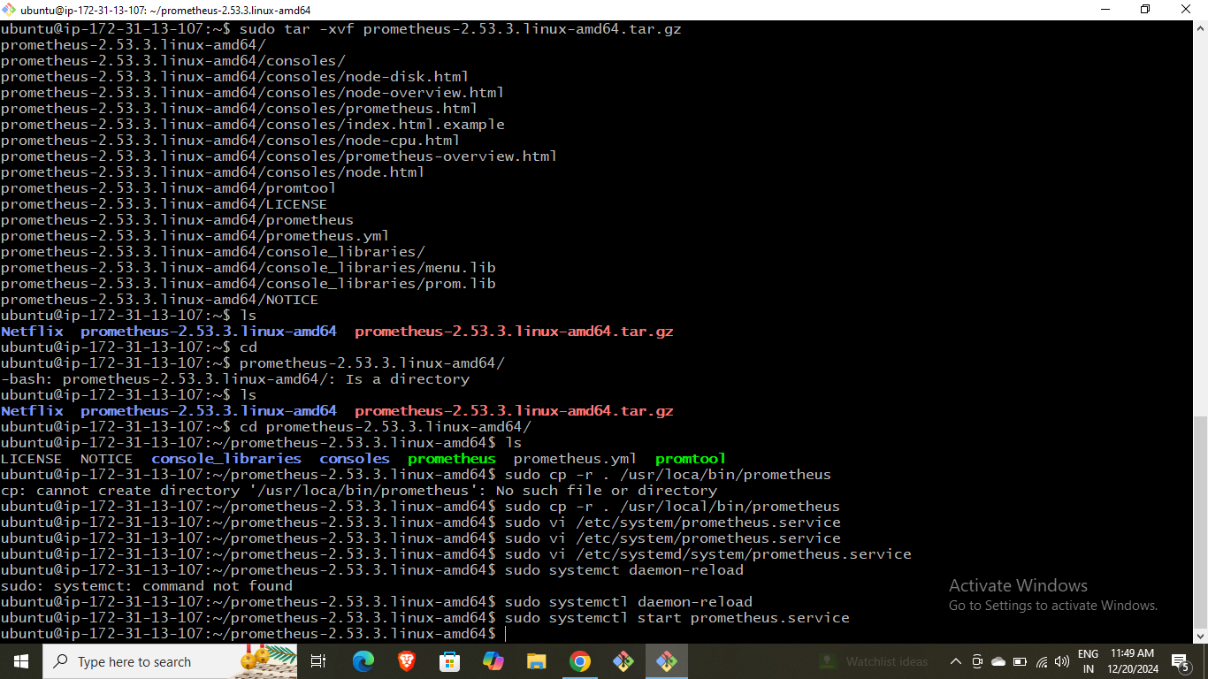
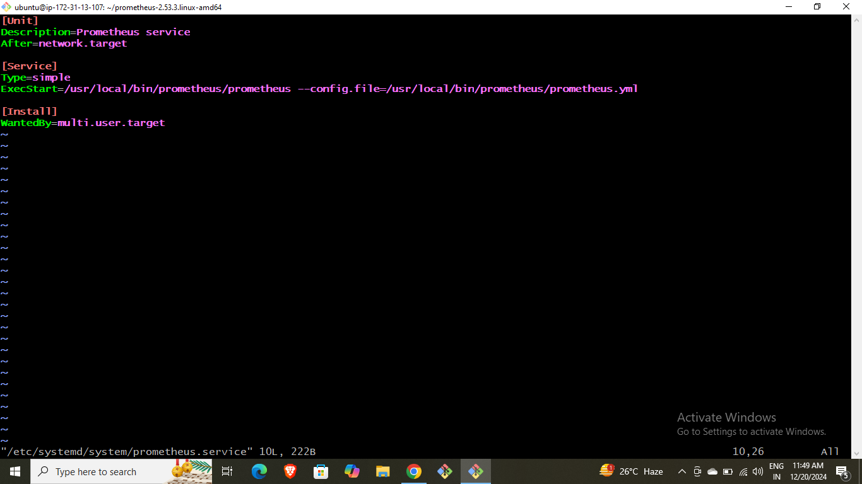
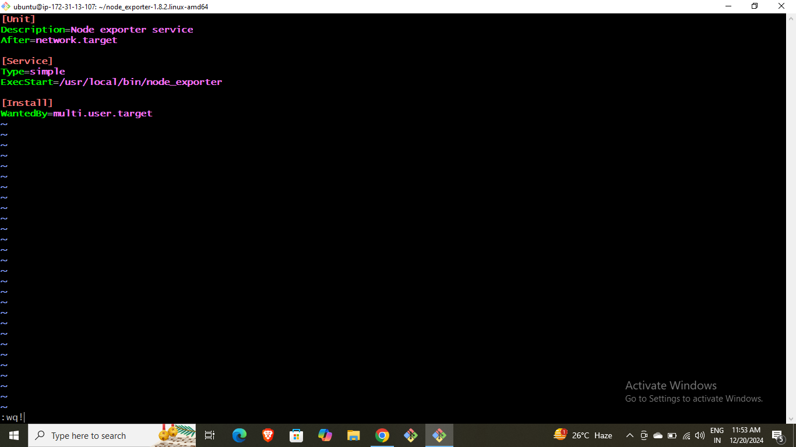
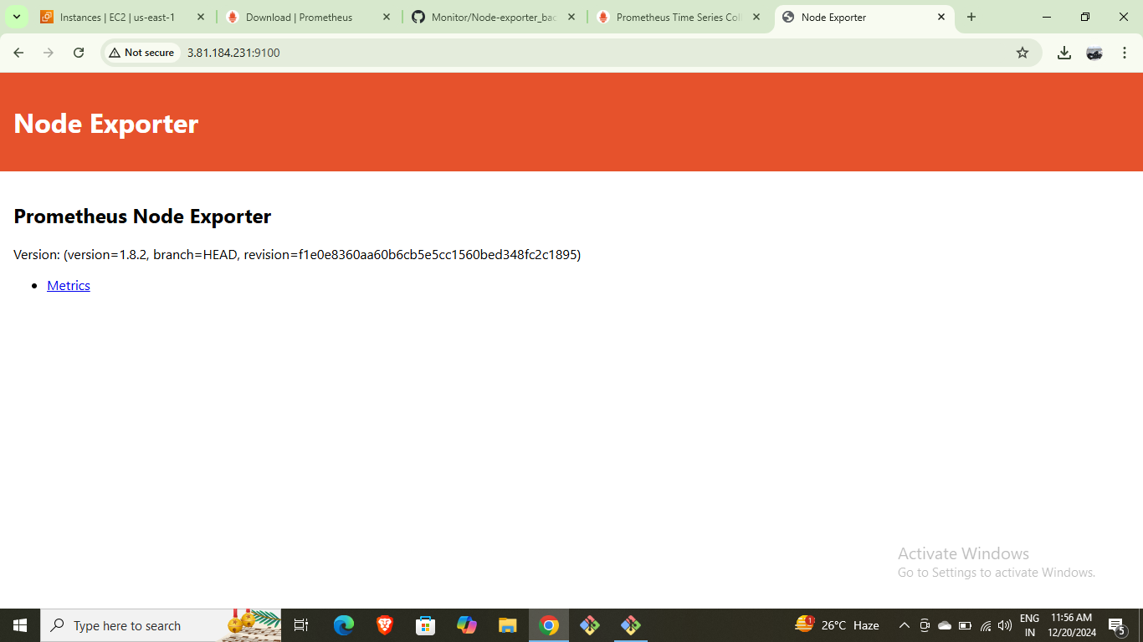
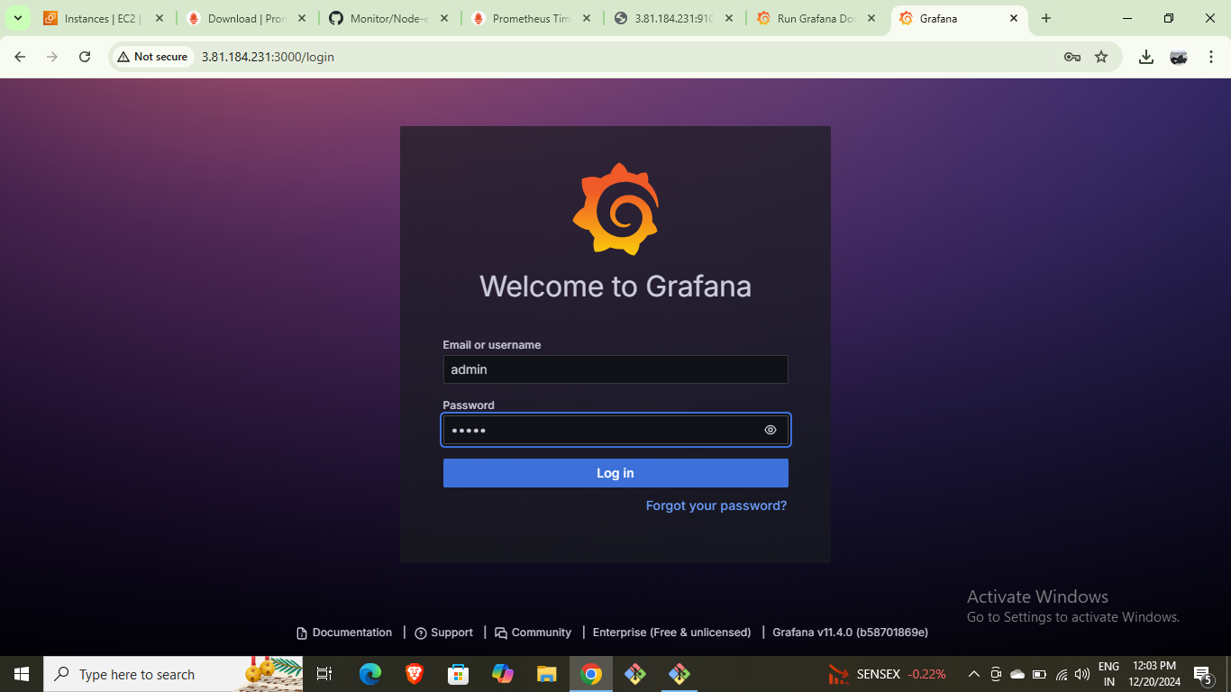
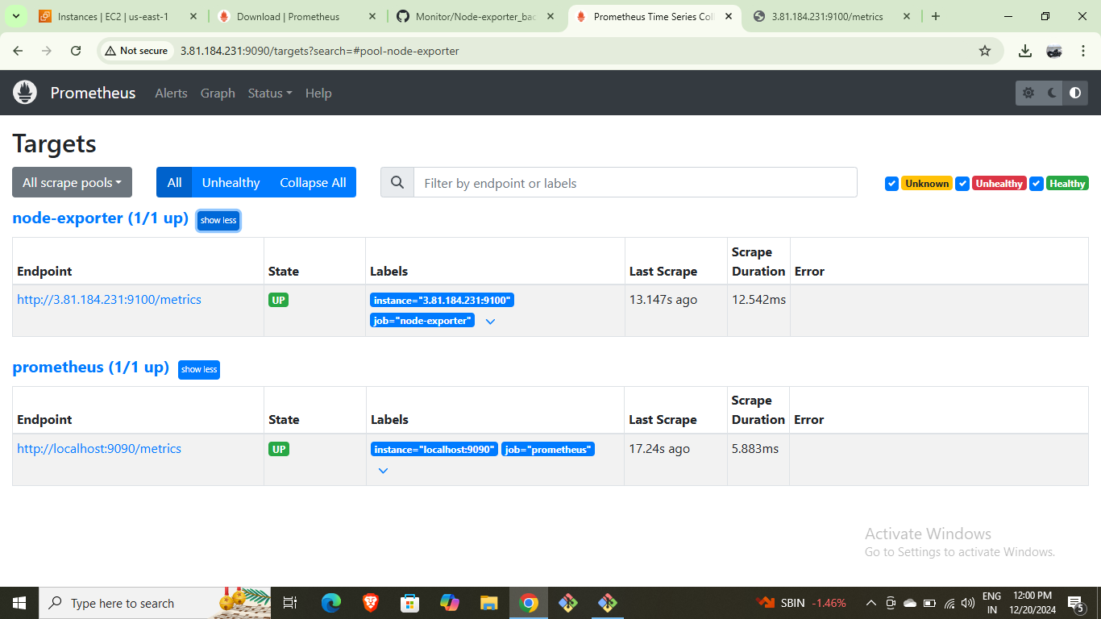
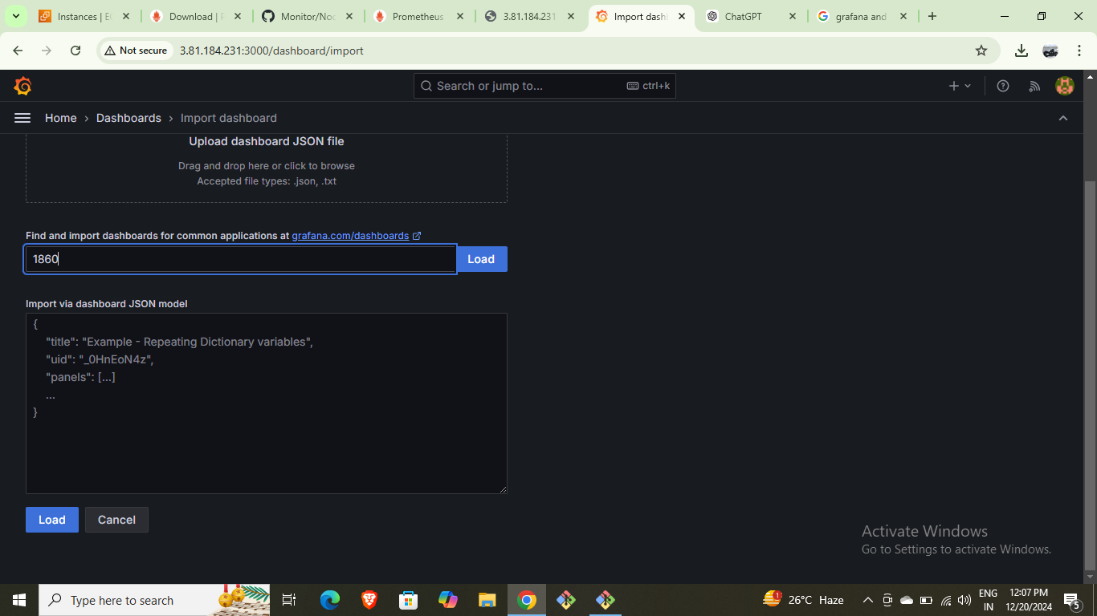
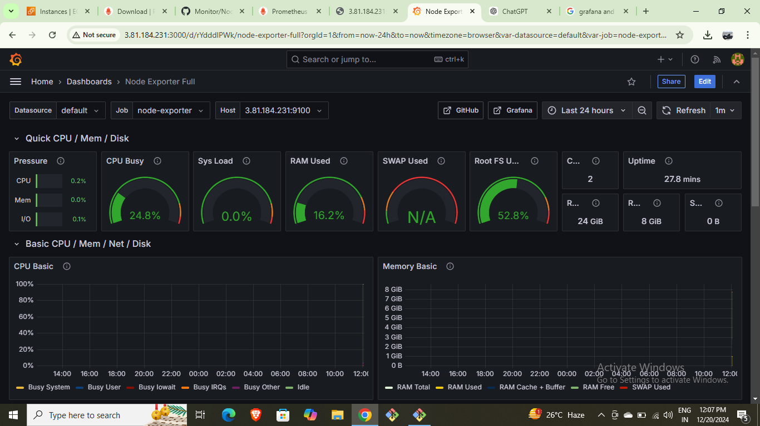
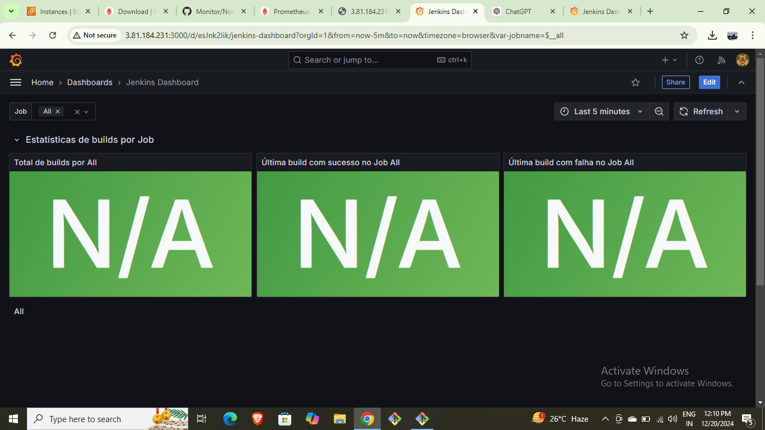

Slide 10
Phase 5: Deployment with EKS and ArgoCD
Create and configure an EKS cluster.
Install Helm for Kubernetes package management.
Install ArgoCD for continuous deployment.
Sync applications and deploy Netflix clone using Kubernetes.

Slide 11
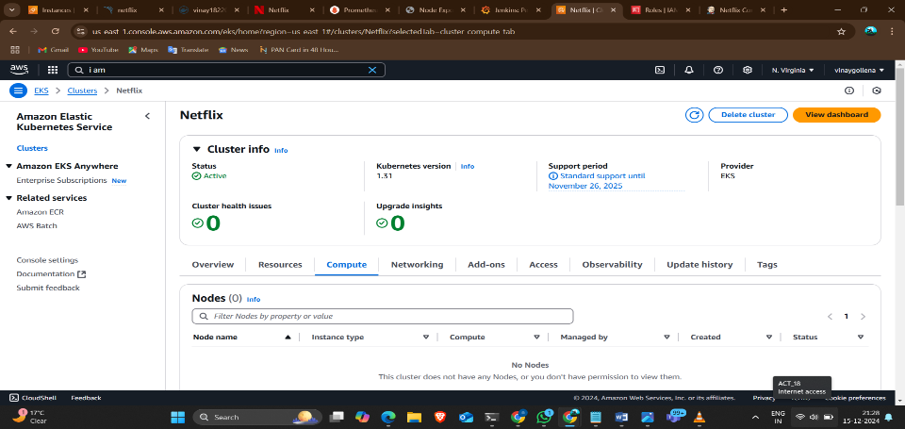
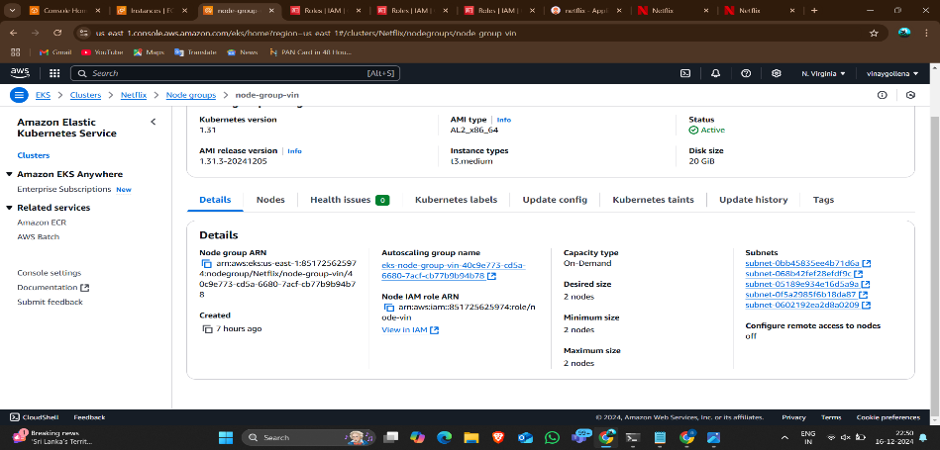
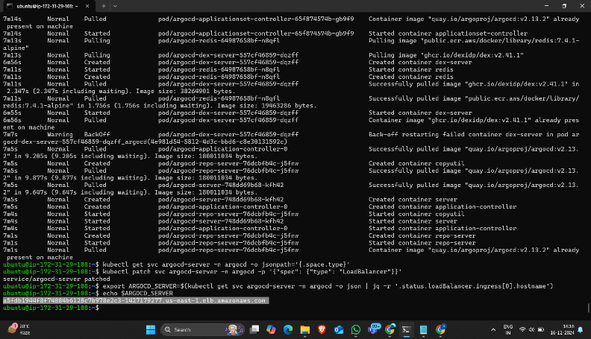
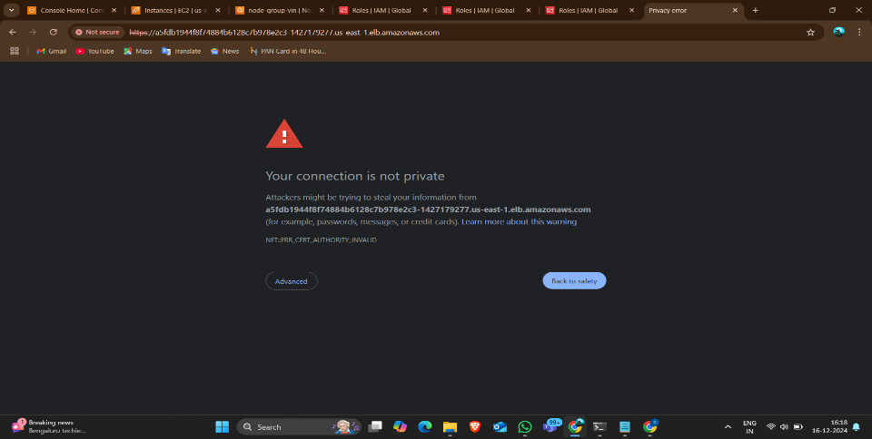
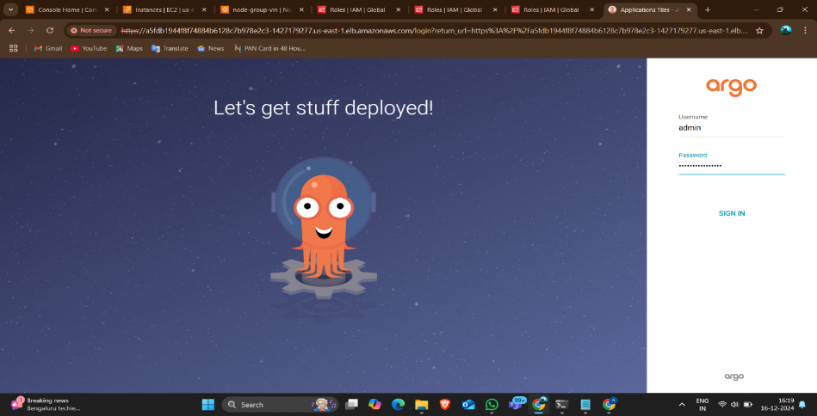
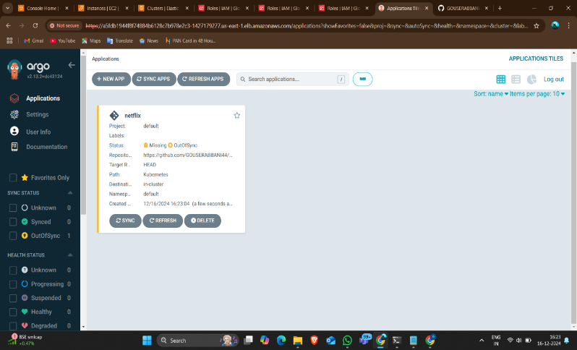
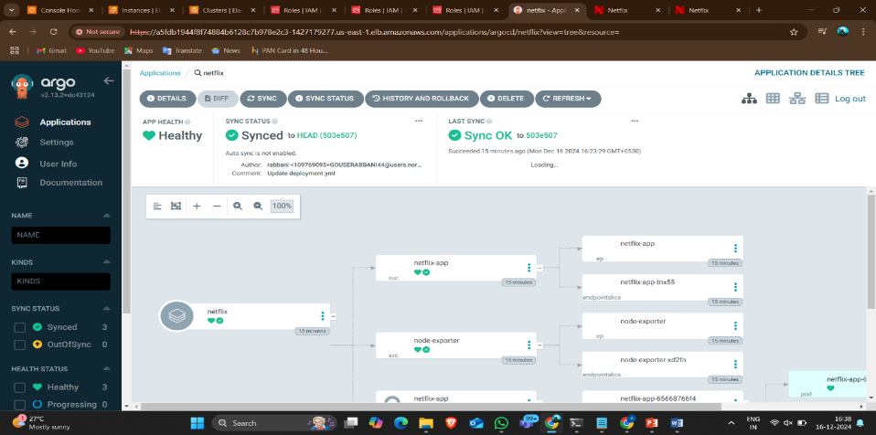
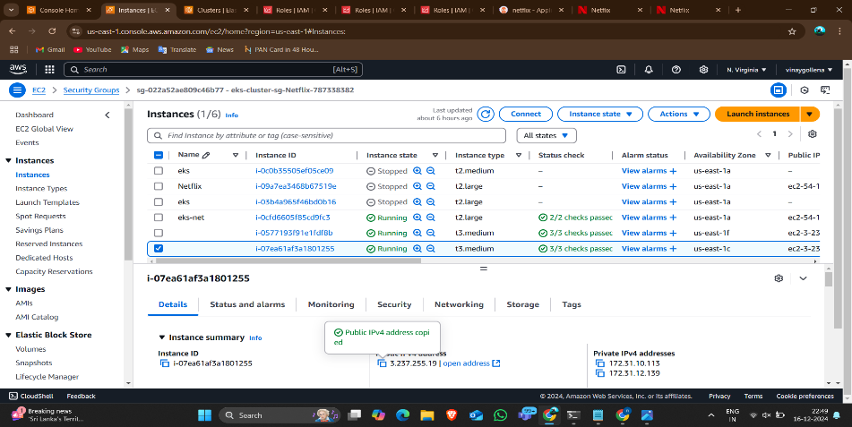
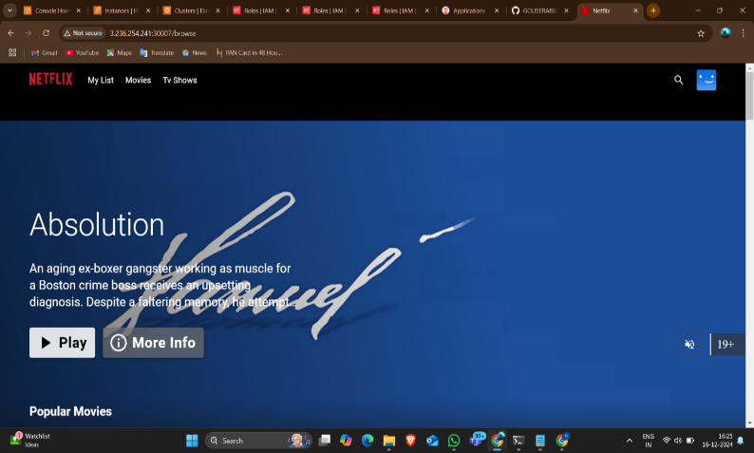

Slide 12
